Slide 1
“Amen”
Praise be to the Lord, the God of Israel, from everlasting to everlasting. Let all the people say, “Amen!” Praise the Lord.
Psalm 106:48

Slide 2
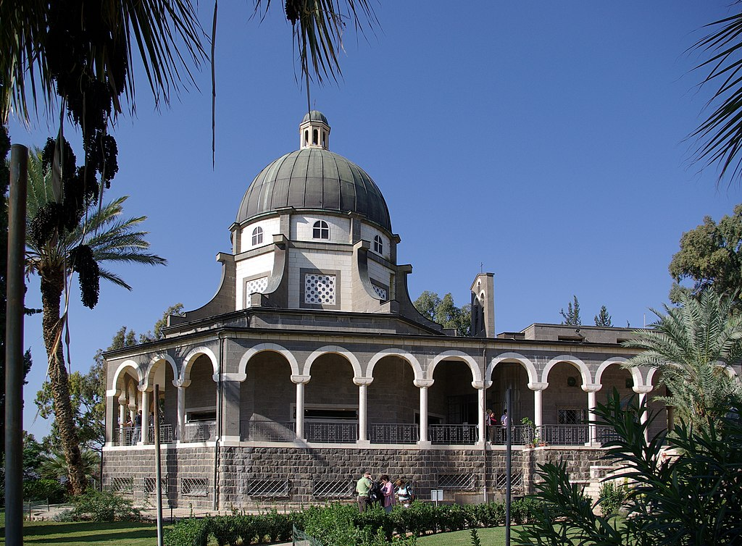
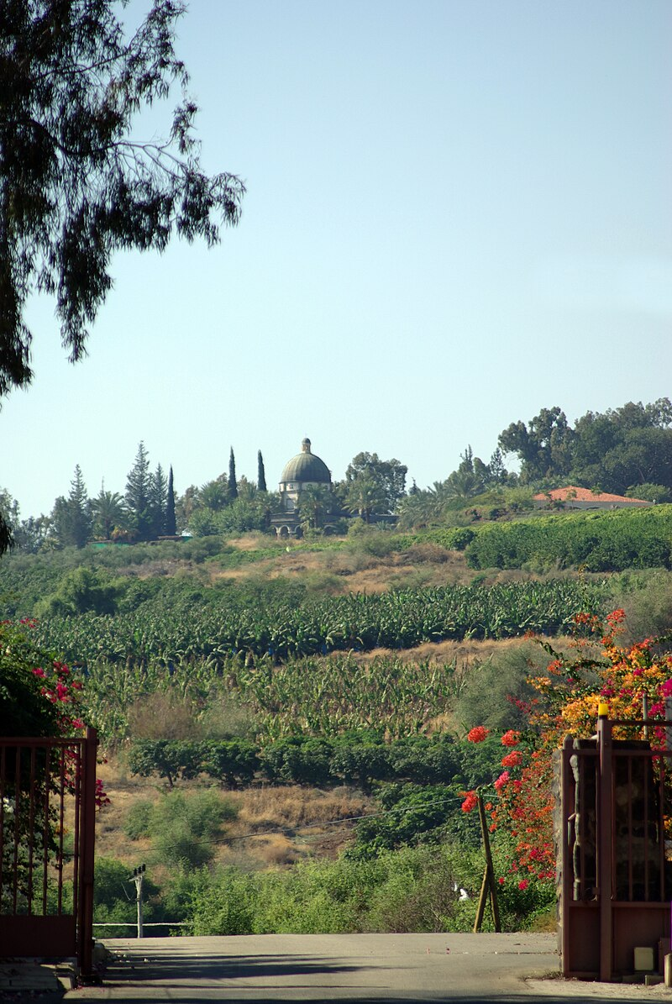

Slide 3
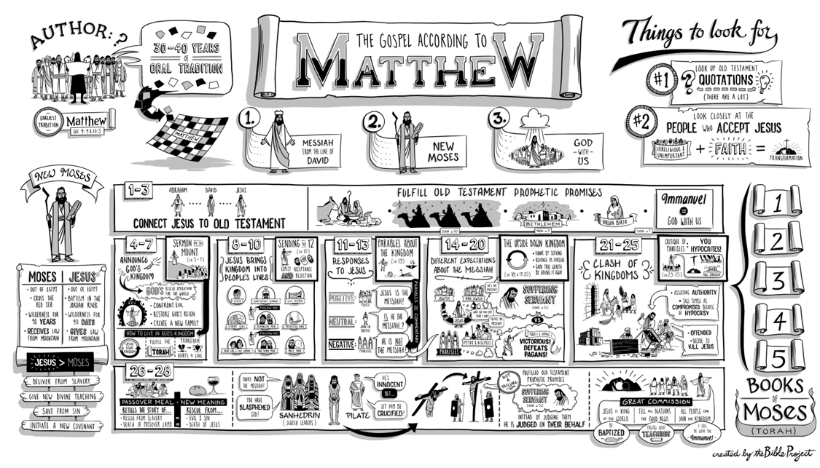

Slide 4
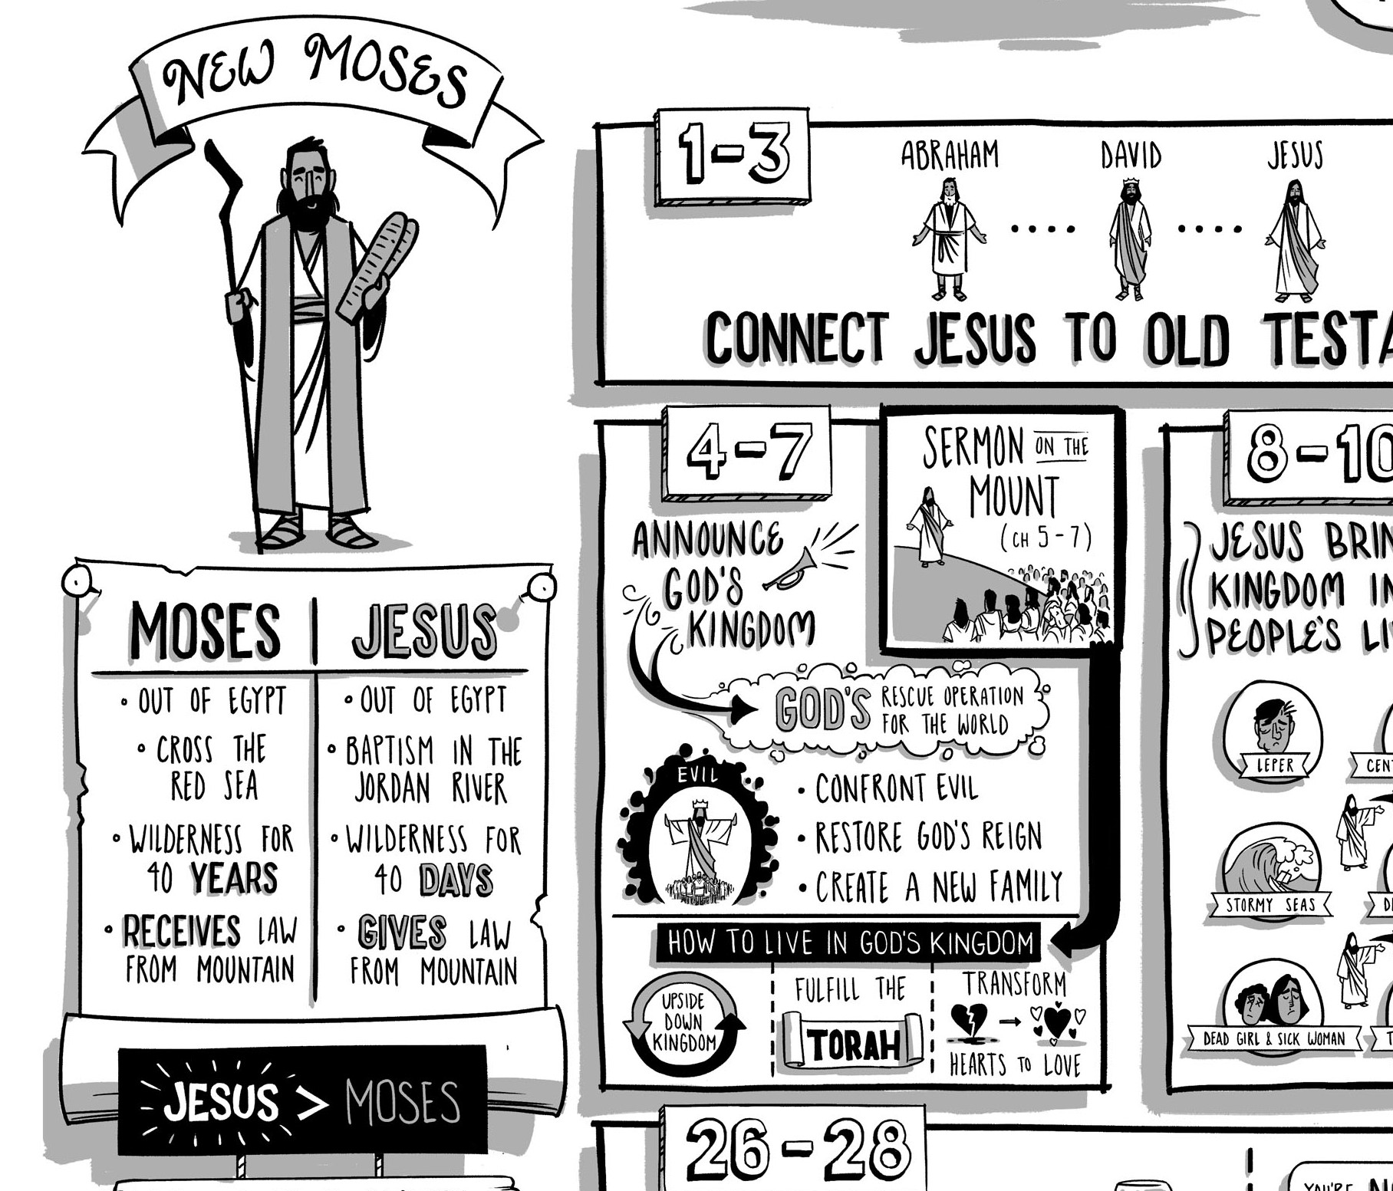

Slide 5
“Our Father in heaven, hallowed by your name, your kingdom come, your will be done on earth as it is in heaven.
Give us today our daily bread.
Forgive us our debt, as we also have forgiven our debtors.
And lead us not into temptation, but deliver us from the evil one, for yours is the kingdom and the power and the glory forever. Amen”

Slide 7
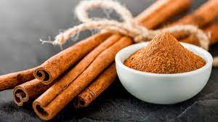

Slide 8
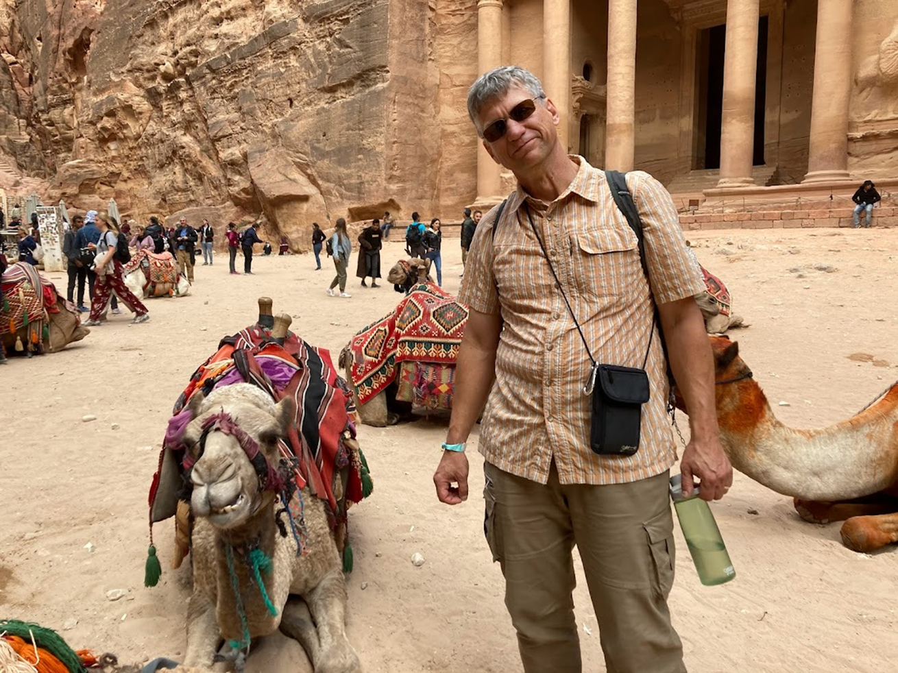
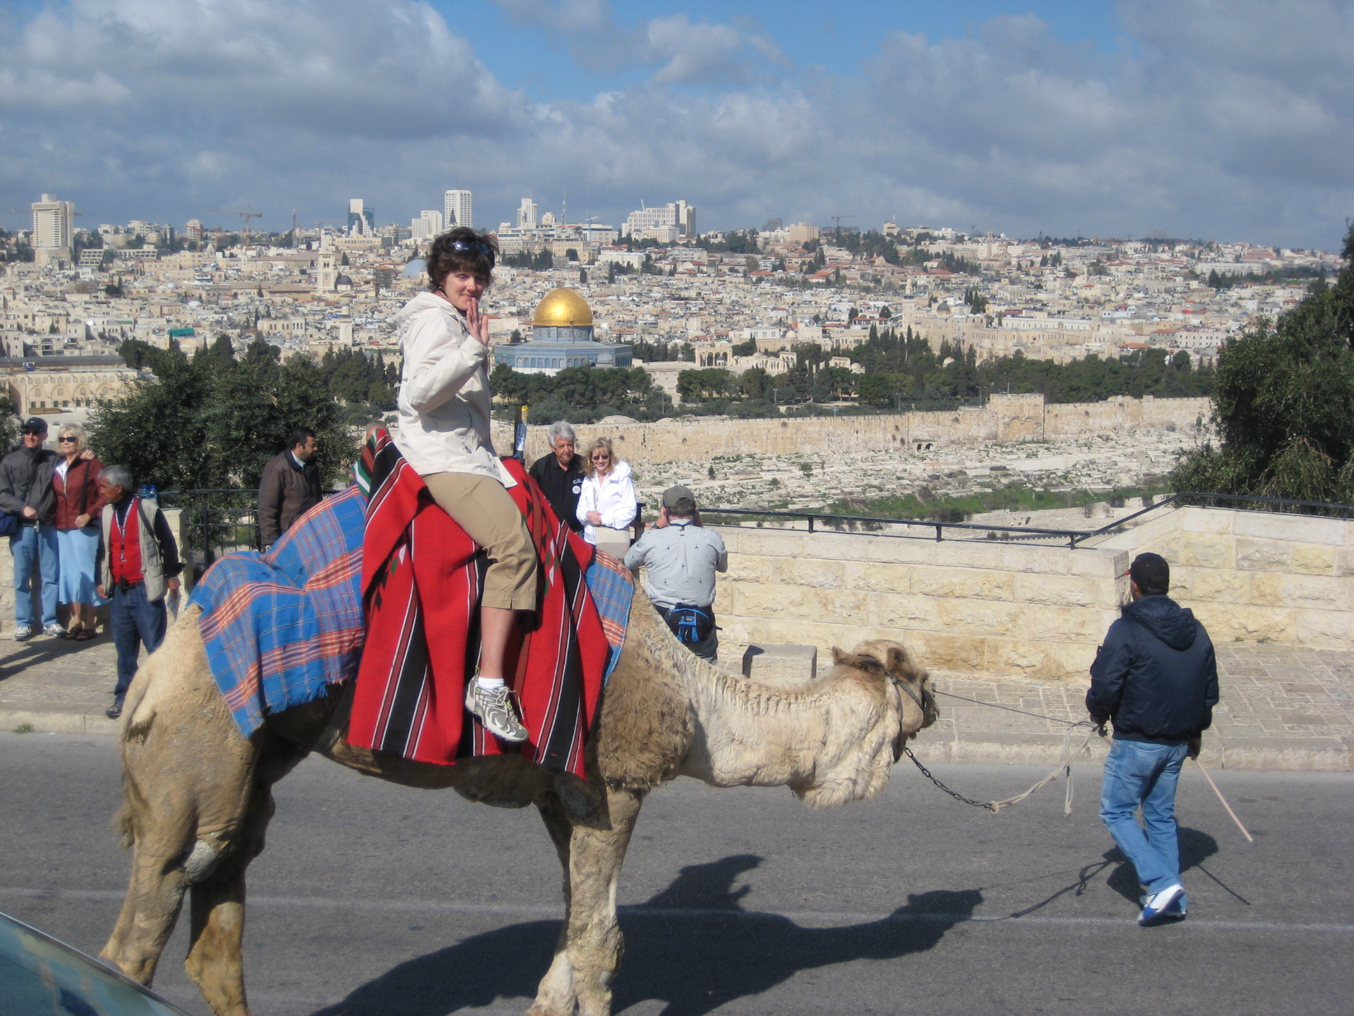

Slide 9
Ending with “Amen”
For yours is the kingdom and the power and the glory forever. Amen.
Matthew 6:13 (NIV footnotes)

Slide 10
Heidelberg Catechism, Lord’s Day 52
Q 129. What does that little word “Amen” express?
A. “Amen” means:
This shall truly and surely be!
It is even more sure that God listens to my prayer than that I really desire what I pray for.

Slide 11
Ending with “Amen”
1. Doug has the same reasons for including “Amen,” only more so
2. “Amen” has been an essential part of the worship of God’s people
3. The catechism is right on!

Slide 12
Revelation 3:14 (p. 1881)
To the angel of the church in Laodicea write:
These are the words of the Amen, the faithful and true witness, the ruler of God’s creation . . . .

Slide 13
Ending with “Amen”
1. Doug has the same reasons for including “Amen,” only more so
2. “Amen” has been an essential part of the worship of God’s people
3. The catechism is right on!
4. Even the “Amen” looks forward to Jesus

Slide 14
Isaiah 65:16 (p. 1164)
Whoever invokes a blessing on the land will do so by the God of truth; he who takes an oath in the land will swear by the God of truth.
For the past troubles will be forgotten and hidden from their eyes.

Slide 15
A short history of Amen
The Levites shall recite to all the people of Israel in a loud voice: “Cursed is the man who carves an image or casts an idol – a thing detestable to the Lord, the work of the craftsman’s hands – and sets it up in secret.” Then all the people shall say, “Amen.”
Deuteronomy 27

Slide 16
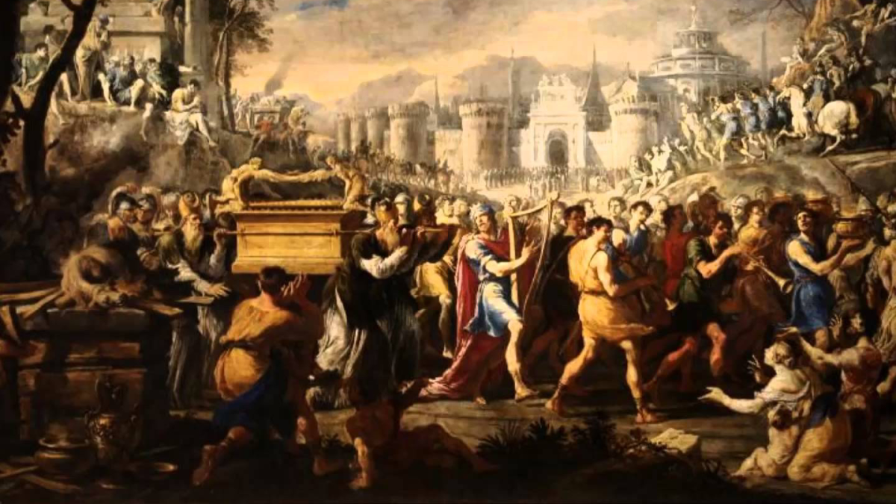
Notes:
Domenico Garguilo, 1640s

Slide 17
1 Chronicles 16:36 (p. 651)
Give thanks to the Lord, for he is good; his love endures forever . . . .
Praise be to the Lord, the God of Israel, from everlasting to everlasting.
Then all the people said, “Amen” and “Praise the Lord.”

Slide 18
Jeremiah 28:5 (p. 1220)
Then the prophet Jeremiah replied to the prophet Hananiah before the priests and all the people who were standing in the house of the Lord. He said, “Amen! May the Lord fulfill the words you have prophesied . . . .”

Slide 19
Nehemiah 8:5 (p. 762)
Ezra opened the book. All the people could see him because he was standing above them; and as he opened it, the people all stood up. Ezra praised the Lord, the great God; and all the people lifted their hands and responded, “Amen! Amen!”
Then they bowed down and worshiped the Lord with their faces to the ground.

Slide 20
Matthew 5:17 (p. 1502)
“Do not think that I have come to abolish the Law or the Prophets; I have not come to abolish them but to fulfill them. I tell you the truth, until heaven and earth disappear, not the smallest letter, not the least stroke of the pen, will my any means disappear from the Law until everything is accomplished.”

Slide 21
Romans 11:33-36 (p. 1763)
Oh, the depths of the riches of the wisdom and knowledge of God!
How unsearchable his judgments and his paths beyond tracing out . . . .
For from him and through him and to him are all things.
To him be the glory forever! Amen.

Slide 22
Revelation 5:13 (p. 1919)
Then I heard every creature in heaven and on earth and under the earth and on the sea, and all that is in them singing:
“To him who sits on the throne and to the Lamb be praise and honor and glory and power, for ever and ever.
The four living creatures said “Amen” and the elders fell down and worshiped.

Slide 23
Revelation 22:18-21 (p. 1939)
I warn everyone who hears the words of the prophecy of this book . . . .
He who testifies to these things says, “Yes, I am coming soon.”
Amen. Come, Lord Jesus.
The grace of the Lod Jesus be with God’s people.

Slide 24
What we learn from history
1. “Amen” seems to be an essential part of the worship of God’s people
2. There is great value in the embodied response of God’s people
3. “Amen” is part of the song of heaven

Slide 26
Saying “Amen” today
Each of you should use whatever gift he has received to serve others, faithfully administering God’s grace in its various forms.
1 Peter 4:10
1. Say “Amen” to grace in the church

Slide 27
Saying “Amen” today
I warn everyone who hears the words of the prophecy of this book: If anyone adds anything . . . And if anyone takes anything away . . .
Revelation 22
2. Say “Amen” to the authority of “this book”

Slide 28
Saying “Amen” today
[Jeremiah] said, “Amen! May the Lord do so! May the Lord fulfill the words you have prophesied . . . . Nevertheless, listen to what I have to say in your hearing . . . .
Jeremiah 28:5

Slide 29
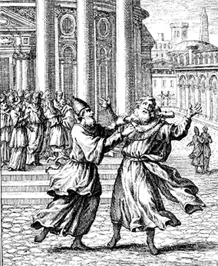

Slide 30
Saying “Amen” today
[Jeremiah] said, “Amen! May the Lord do so! May the Lord fulfill the words you have prophesied . . . . Nevertheless, listen to what I have to say in your hearing . . . .
Jeremiah 28:5
3. Say “Amen” for confidence in what God has already said

Slide 35
The benefits of prayer
1) Prayer is a discipline of dependence

Slide 36
Heidelberg Catechism, Lord’s Day 44
Q 115. No one in this life can obey the Ten Commandments perfectly: Why then does God want them preached so pointedly?
A. First, so that the longer we live the more we may come to know our sinfulness and the more eagerly look to Christ for forgiveness and righteousness.

Slide 37
Heidelberg Catechism, Lord’s Day 44
Q 115. No one in this life can obey the Ten Commandments perfectly: Why then does God want them preached so pointedly?
A . First . . . .
Second, so that while praying to God for the grace of the Holy Spirit, we may never stop striving to be renewed more and more after God’s image, until after this life we reach our goal: perfection.

Slide 38
The benefits of prayer
1) Prayer is a discipline of dependence
2) Prayer is how the Holy Spirit works

Slide 39
Matthew 6:19 (p. 1504)
“Do not store up for yourselves treasures on earth, where moth and rust destroy, and where thieves break in and steal. But store up for yourselves treasures in heaven . . . .”

Slide 40
The benefits of prayer
1) Prayer is a discipline of dependence
2) Prayer is how the Holy Spirit works
3) Prayer is an investment

Slide 41
The first petition
. . . turns our eyes to the character and mission of God
. . . reveals the ethics o
. . . revolves around the three pillars of Jewish piety
. . . moves from external to internal matters – the heart of the issue

Slide 45
Paul writes back to where he first wrote from
1) Unity, but not at the cost of righteousness

Slide 46
1 Corinthians 1:4-9 (p. 1771)
¹⁰ I appeal to you, brothers, in the name of our Lord Jesus Christ, that all of you agree with one another so that there may be no divisions among you and that you may be perfectly united in mind and thought . . . .

Slide 47
1 Corinthians 1 (p. 1772)
⁹ I have written you in my letter not to associate with sexually immoral people— ¹⁰ not at all meaning the people of this world who are immoral . . . .
¹¹ But now I am writing you that you must not associate with anyone who calls himself a brother but is sexually immoral or greedy, an idolater or a slanderer, a drunkard or a swindler. With such a man do not even eat.

Slide 48
Paul writes back to where he first wrote from
1) Unity, but not at the cost of righteousness
2) Paul reverses the order of instructions regarding brotherly love and sexual immorality

Slide 49
1 Thessalonians 4:3 (p. 1840)
It is God’s will that you should be sanctified: that you should avoid sexual immorality, that each of you should learn to control his body in a way that is holy and honorable . . . and that in this manner no one should wrong his brother or take advantage of him.

Slide 50
Washed, Sanctified, Justified
Picture 1: Paul’s own testimony
Picture 2: Answering the “Who do I belong to?” question
Picture 3: Answering the “How do the ‘some of us’ find peace with God?” question

Slide 51
Washed, Sanctified, Justified
Picture 2: To whom do I belong?
Flee sexual immorality . . . . Do you not know that your body is the temple of the Holy Spirit, who is in you, whom you have received from God? You are your own, you were bought with a price.
1 Corinthians 6:18-20

Slide 52
Washed, Sanctified, Justified
Picture 3: Finding peace with God
Therefore, since we are justified through faith, we have peace with God through our Lord Jesus Christ.
Romans 5:1

Slide 53
More “more and more”
Finally, brothers, we instructed you how to live in order to please God, as in fact you are living. Now we ask and urge you in the Lord Jesus to doe this more and more. For you know the instructions we gave you by the authority of the Lord Jesus.
1 Thessalonians 4:1

Slide 54
More “more and more”
1) We start with a commitment to Scripture
2) We practice wisdom and hospitality
3) We find solidarity in prayer

Slide 58
1 Thessalonians 2:1-5 (p. 1838)
We loved you so much that we were delighted to share with not only the gospel of God, but our lives as well, because you had become so dear to us.

Slide 59
1 Thessalonians 2:10-12 (p. 1838)
You are witnesses, and so is God, of how holy, righteous and blameless we were among you who believed. For you know that we dealt with you as a father deals with his own children, encouraging, comforting and urging you to live lives worthy of God, who calls you into his kingdom and glory.

Slide 60
Colossians 1:9-14 (p. 1838)
And we pray this in order that you may live a life worthy of the Lord, and may please him in every way: bearing fruit in every good work growing in the knowledge of God being strengthened with all power . . . giving thanks to the Father . . . . For he has rescued us from the dominion of darkenss and

Slide 61
Colossians 1:9-14 (p. 1838)
For he has rescued us from the dominion of darkness and brought us into the kingdom of the Son he loves, in whom we have redemption, the forgiveness of sins.

Slide 62
1 Thessalonians 2:13-14 (p. 1838)
And we also thank God because you, when you received the word of God, which you heard from us, you accepted it not as the word of men, but as it actually is, the word of God, which is at work in you who believe. For you, brothers, became imitators of God’s churches in Judea, which are in Christ Jesus . . . .

Slide 63
1 Thessalonians 2:13-14 (p. 1838)
For you, brothers, became imitators of God’s churches in Judea, which are in Christ Jesus: You suffered from your own countrymen the same things those churches suffered from the Jews . . . .

Slide 65
The amazement of eternal life
Amazement 1: This is just the kind of person who would make a great disciple

Slide 66
The amazement of eternal life
Amazement 1: This is just the kind of person who would make a great disciple
Amazement 2: How is anyone going to be saved?

Slide 67
The amazement of eternal life
1) Eternal life and entering the kingdom of God are two ways to experience salvation, and rich people aren’t the only ones who need Jesus’ righteousness
2) Matthew ends this encounter by showing just how much I depend on God’s generosity (Matthew 20:1-16)

Slide 68
Messiah lessons
“Not so with you. Instead, whoever wants to become great among you must be your servant, and whoever wants to be first must be the slave of all. For even the Son of Man did come to be served but to serve, and to give his life as a ransom for many”
Mark 10:42-45

Slide 69
Messiah lessons
1) Jesus is going to reveal Messiah’s love in ways that will be even more amazing
But God demonstrates his own love for us in this: While we were still sinners, Christ died for us.
Romans 5:8

Slide 70
Messiah lessons
2) We learn some surprises about Messiah-followers
“I tell you the truthy, no one who left home . . . for me and the gospel will fail to receive a hundred times as much in the present age . . . and with them persecutions) and in the age to come, eternal life.
Mark 10:29-31

Slide 71
Messiah lessons
3) Jesus’ love allows us to discern the “rubbish”
But whatever was to my profit I now consider loss for the sake of Christ . . . . I consider them rubbish that I may gain Christ and be found in him, not having a righteousness of my own . . . .
Philippians 3:7-11

Slide 73
Philippians 2:14 (p. 1828)
Do everything without complaining or arguing, so that you become blameless and pure, children of God without fault in a crooked and depraved generation . . . .
1 Peter 4:9 (p. 1891)
Offer hospitality to one another without grumbling. Each one should use whatever gift he has received to serve others, faithfully administer God’s grace . . . .

Slide 74
Genesis 2:19-25 (p. 4)
Now the Lord God had formed out of the ground all of the beasts of the field and all the birds of the air. He brought them to the man to see what he would name them . . . . But for Adam no suitable helper was found.

Slide 75
Heidelberg Catechism, Lord’s Day 25
Q 66. What are sacraments?
A. Sacraments are holy signs for us to see.
They were instituted by God so that by our use of them he might make us understand more clearly the promise of the gospel, and might put his seal on that promise.
And this is the promise: to forgive our sins and give us eternal life by grace alone because of Christ’s one sacrifice finished on the cross.

Slide 76
OWBTG, Article 16
All spheres of life
—family and friendship, work and worship, school and state, play and art— bear the wounds of our rebellion. Sin is present everywhere—in pride of race, arrogance of nations, abuse of the weak and helpless, disregard for water, air, and soil . . . .

Slide 77
Belgic Confession, Art. 17 (p. 77)
We believe that our good God, by his marvelous wisdom and goodness, seeing that man had plunged himself in this manner into both physical and spiritual death and made himself completely miserable.
set out to find him, though man, trembling all over was fleeing from him.

Slide 78
The gospel is this: We are more sinful and flawed in ourselves than we ever dared believe, yet at the very same time we are more loved and accepted in Jesus Christ than we ever dared hope.
Timothy Keller
The Meaning of Marriage

Slide 79
Genesis 3:16 (p. 6)
Your desire will be for your husband, but he will rule over you.
1 Peter 5:8 (p. 1892)
Be self controlled and alert. Your enemy the devil prowls around like a roaring lion looking for someone to devour. Resist him, standing firm in the faith . . . .

