Slide 1
The Gospel in Creation
God saw all that he had made, and it was very good. And there was evening, and there was morning – the sixth day. Thus the heavens and the earth were completed in all their vast array.
Genesis 1:31-2:1

Slide 2
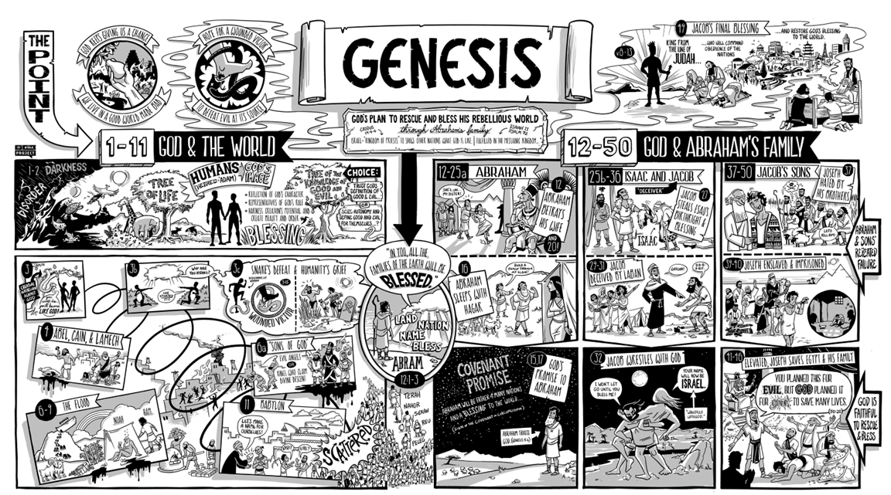

Slide 4
Order out of Chaos
In the beginning God created the heavens and the earth. Now the earth was formless and empty, darkness was over the surface of the deep, and the Spirit of God was hovering over the waters.
Genesis 1:1-2

Slide 5
Genesis 1:3-5
And God said let there be light,” and there was light
God saw that the light was good, and he separated the light from the darkness. God called the light “day,” and the darkness he called “night.”
And there was evening and the was morning – the first day.

Slide 6
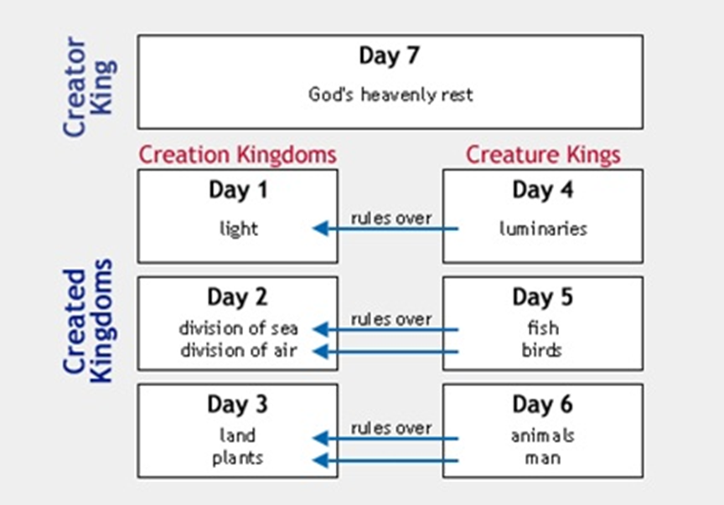

Slide 7
Genesis 1:31-2:1
And God blessed them and said to them, “Be fruitful and increase in number, fill the earth and subdue it . . . .”
God saw all that he had made, and it was very good. And there was evening, and there was morning – the sixth day. Thus the heavens and the earth were completed in all their vast array.

Slide 9
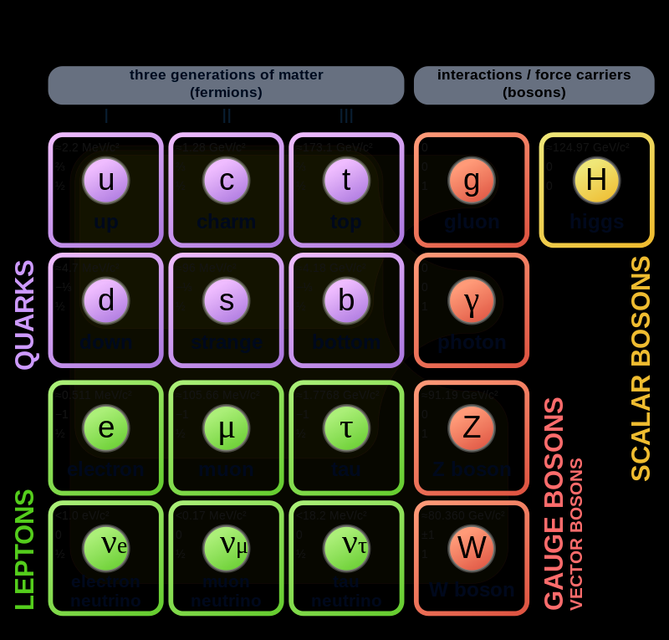

Slide 11
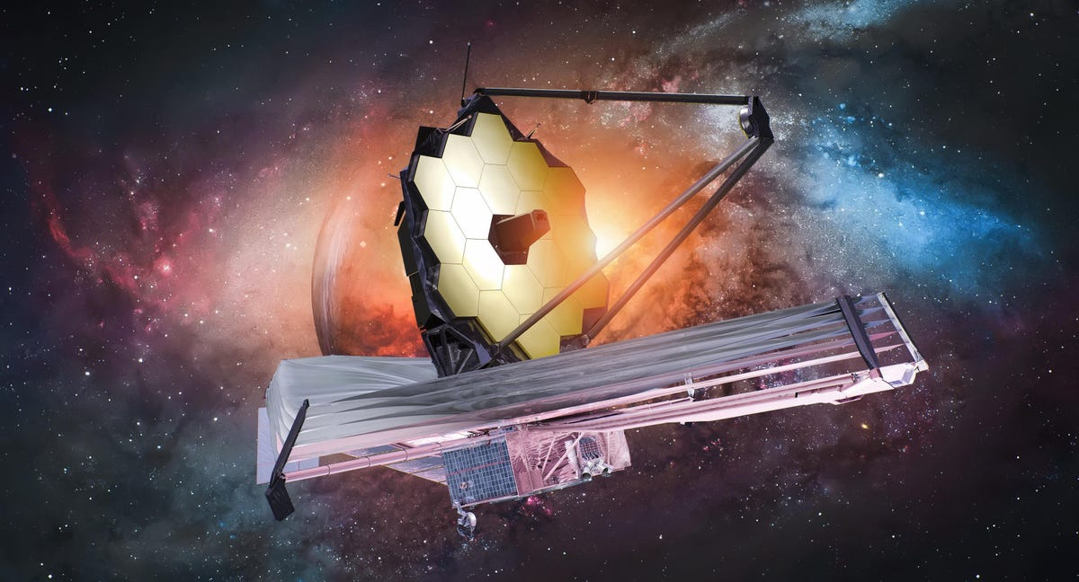

Slide 12
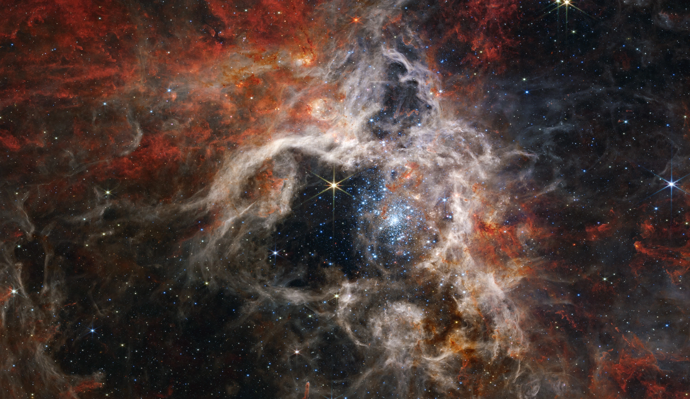

Slide 13
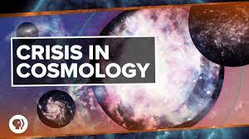

Slide 14
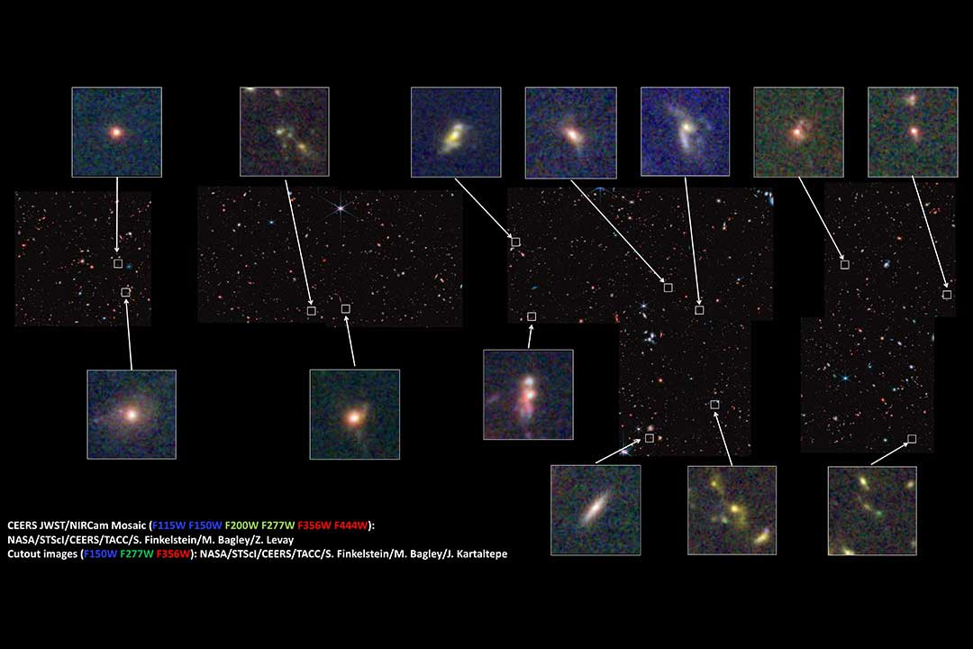

Slide 15
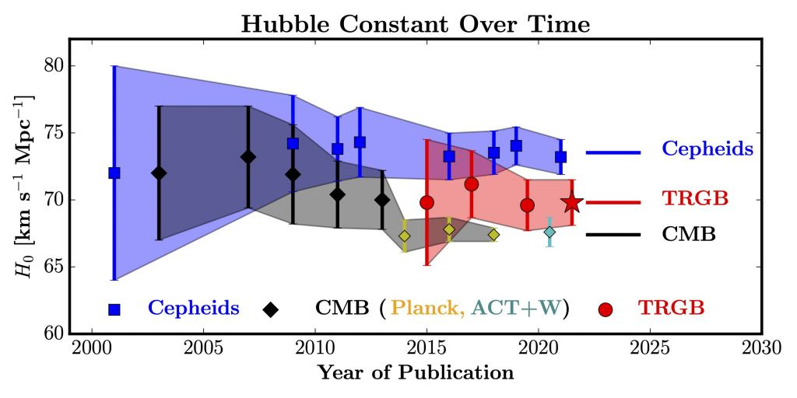

Slide 20
The first lō tōv
This is the account of the heavens and the earth when they were created . When the Lord God made the earth and the heavens . . . .
Genesis 2:4

Slide 21
The first lō tōv
The Lord God took the man and put him in the Garden of Eden to work it and take care of it. And the Lord God commanded the man, “You are free to eat from any tree in the garden, but you must not eat from the tree of the knowledge of good and evil, for when you eat of it you will surely die.”
Genesis 2:15-18

Slide 22
The first lō tōv
The Lord God said, “It is not good for the man to be alone. I will make a helper suitable for him.”
Genesis 2:15-18

Slide 23
Genesis 2:20b-23
But for Adam no suitable helper was found. So the Lord God caused the man to fall into a deep sleep . . . .
Then the Lord God made a woman from the rib he had taken out of the man, and he brought her to the man.
The man said, “This is now bone of my bones and flesh of my flesh; she shall be called woman, for she was taken out of man.

Slide 25
Living into blessing and goodness
So God created man in his image, in the image of God he created him; male and female he created them. And God blessed them . . . .
Genesis 1:27-28

Slide 26
Living into blessing and goodness
1) Torah begins with the same God who speaks words to reveal his heart
And God spoke all these words: “I am the Lord your God who brought you out of Egypt, out of the land of slavery. You shall have no other gods before me.”
Exodus 20:1-2

Slide 27
Exodus 20:4-6 (p. 118)
You shall not make for yourself an idol in the form of anything in the heaven above or in the earth beneath or in the waters below. You shall not bow down to them or worship them . . . .

Slide 28
Living into blessing and goodness
2) God’s blessing follows the goodness of his creation order
He created them male and female and he blessed them. And when they were created he called them “man.”
Genesis 5:2

Slide 29
Living into blessing and goodness
2) God’s blessing follows the goodness of his creation order
He created them male and female and he blessed them. And when they were created he called them ‘adam.
Genesis 5:2

Slide 30
Living into blessing and goodness
3) If living in paradise required a rescuer, how much more does living under the curse require me to turn to Jesus?
But God demonstrates his own love for us in this: While we were still sinners, Christ died for us.
Romans 5:8

Slide 34
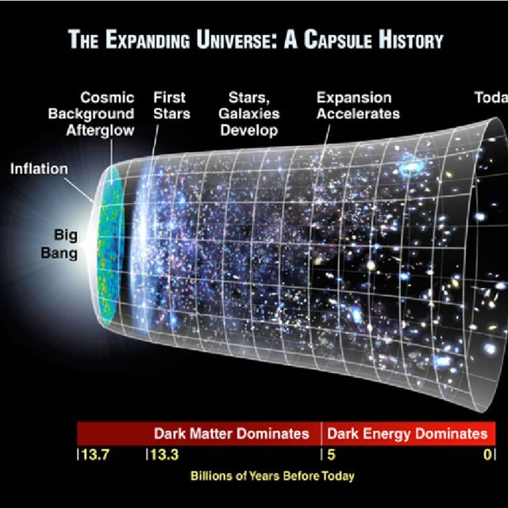

Slide 36
Philippians 2:14 (p. 1828)
Do everything without complaining or arguing, so that you become blameless and pure, children of God without fault in a crooked and depraved generation . . . .
1 Peter 4:9 (p. 1891)
Offer hospitality to one another without grumbling. Each one should use whatever gift he has received to serve others, faithfully administer God’s grace . . . .

Slide 37
Genesis 2:19-25 (p. 4)
Now the Lord God had formed out of the ground all of the beasts of the field and all the birds of the air. He brought them to the man to see what he would name them . . . . But for Adam no suitable helper was found.

Slide 38
Genesis 2:19-25 (p. 4)
So the Lord God caused the man to fall into a deep sleep; and while he was sleeping, he took one of the man’s ribs and closed up the place with flesh. Then the Lord God made a woman from the rib he had taken out of the man, and he brought her to the man.

Slide 39
Genesis 2:19-25 (p. 4)
The man said,
“This is not bone of my bones and flesh of my flesh; she shall be called woman for she was taken out of man.”
For this reason a man will leave his father and mother and be united to his wife, and they will become one flesh.

Slide 40
God’s solution
“I will make a helper suitable for him.”
Genesis 2:18
1) God’s solution is to provide adam with a rescuer

Slide 41
God’s solution
“I will make a helper suitable for him.”
Genesis 2:18
2) God’s solution is to provide adam with one “like opposite”

Slide 42
God’s solution
“I will make a helper suitable for him.”
Genesis 2:18
3) For the second time, the God who speaks the universe into existence gets his hands dirty

Slide 43
God’s solution
“I will make a helper suitable for him.”
Genesis 2:18
4) When he sees ‘ishah, ‘ish “at last” understands who he is

Slide 46
Heidelberg Catechism, Lord’s Day 25
Q 66. What are sacraments?
A. Sacraments are holy signs for us to see.
They were instituted by God so that by our use of them he might make us understand more clearly the promise of the gospel, and might put his seal on that promise.
And this is the promise: to forgive our sins and give us eternal life by grace alone because of Christ’s one sacrifice finished on the cross.

Slide 47
OWBTG, Article 16
All spheres of life
—family and friendship, work and worship, school and state, play and art— bear the wounds of our rebellion. Sin is present everywhere—in pride of race, arrogance of nations, abuse of the weak and helpless, disregard for water, air, and soil . . . .

Slide 48
Belgic Confession, Art. 17 (p. 77)
We believe that our good God, by his marvelous wisdom and goodness, seeing that man had plunged himself in this manner into both physical and spiritual death and made himself completely miserable.
set out to find him, though man, trembling all over was fleeing from him.

Slide 49
The gospel is this: We are more sinful and flawed in ourselves than we ever dared believe, yet at the very same time we are more loved and accepted in Jesus Christ than we ever dared hope.
Timothy Keller
The Meaning of Marriage

Slide 50
Genesis 3:16 (p. 6)
Your desire will be for your husband, but he will rule over you.
1 Peter 5:8 (p. 1892)
Be self controlled and alert. Your enemy the devil prowls around like a roaring lion looking for someone to devour. Resist him, standing firm in the faith . . . .

